Slide 1
Detecting Anomalies in
Weather Patterns
Daniel Reeder

Slide 2
Motivation
Identify time periods in weather data when certain frequencies have anomalous power
Establish a relationship between temperature and precipitation
Specifically, the frequencies with which they fluctuate
Develop a method that can be applied on a larger scale to identify patterns in climate change

Slide 3
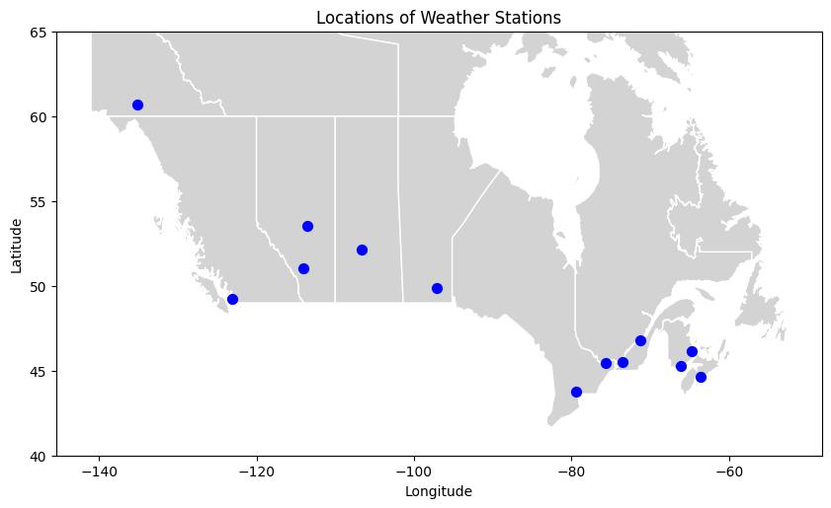
Data
Daily measurements of temperature and precipitation from 1960-2020
13 weather stations across Canada

Slide 4
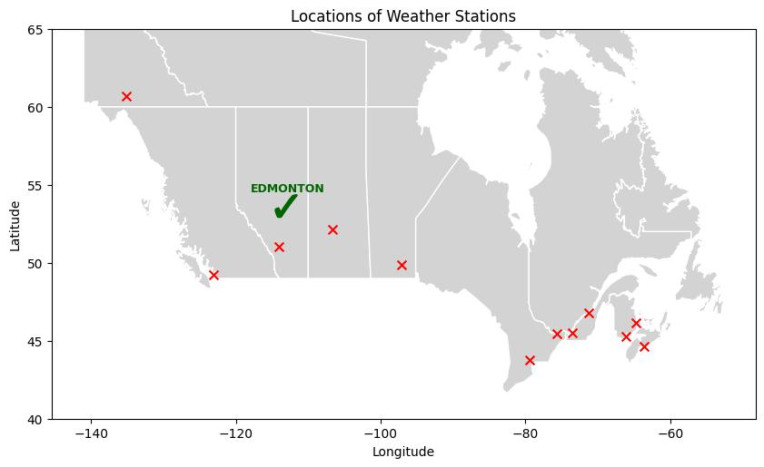
Data
Picked Edmonton to be my focus for this project
Used average daily temperature rather than minimum or maximum
Used total daily precipitation

Slide 5
Methods
Fast Fourier Transform (FFT)
Used to identify key frequencies and select region to focus on
Butterworth Filter
Used to isolate peak frequencies with band-pass filtering
Spectrograms
Used along with filters to analyze changes in strength of frequencies over time
Coherence
Used to confirm the relationship between temperature and precipitation at peak frequencies

Slide 6
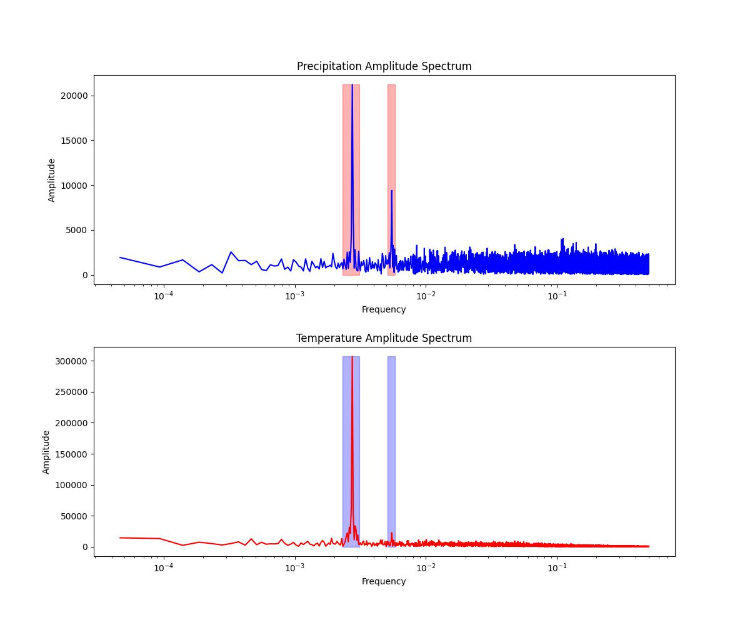
Results - FFT
First plotted amplitude spectra for all locations
Chose Edmonton to focus on because of distinct peaks in both spectra
Temperature and precipitation have two peaks
Major: 2.74x10⁻³ cycles / day → 1 cycle per year (yearly)
Minor: 5.48x10⁻³ cycles / day → 2 cycles per year (bi-yearly)

Slide 7
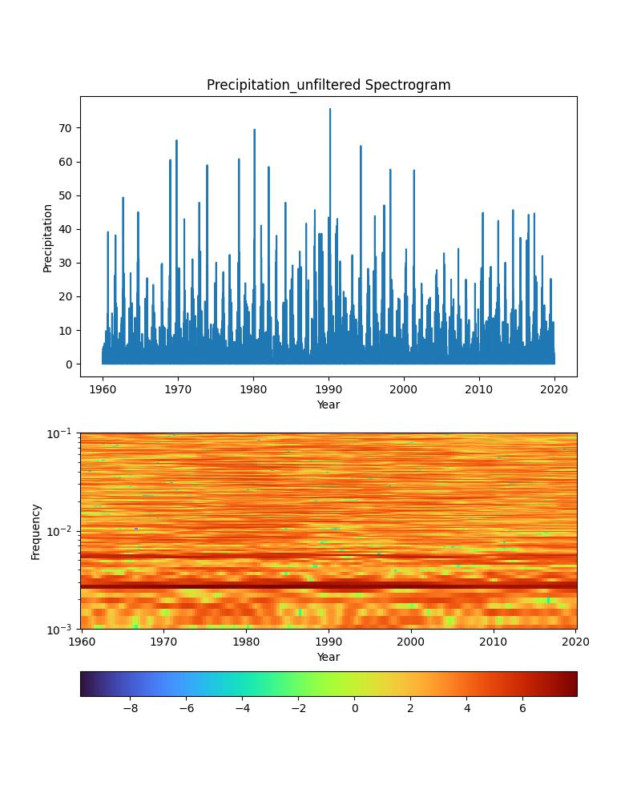
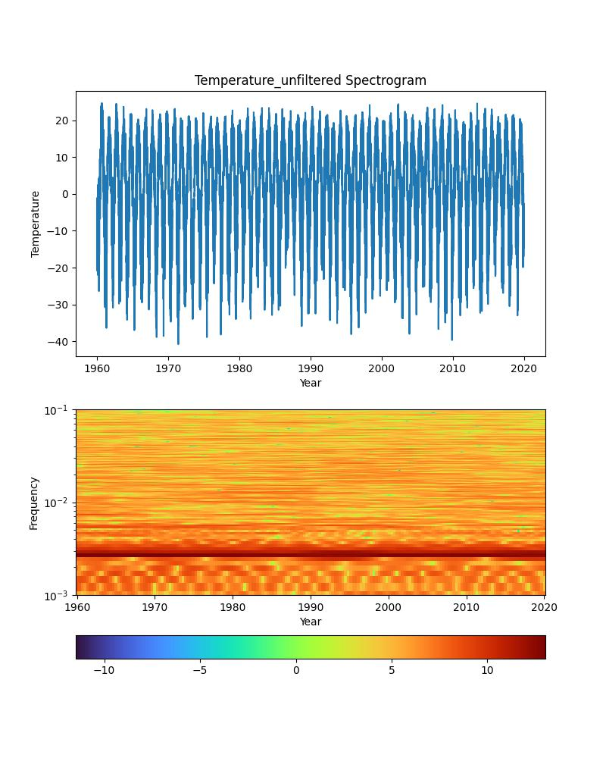
Results - Filters and Spectrograms
Before filtering:
Both temperature and precipitation have dark bands at the expected frequencies
Non-peak frequencies are generally stronger for precipitation than temperature
Non-peak frequencies fluctuate in strength but no anomalies stand out

Slide 8
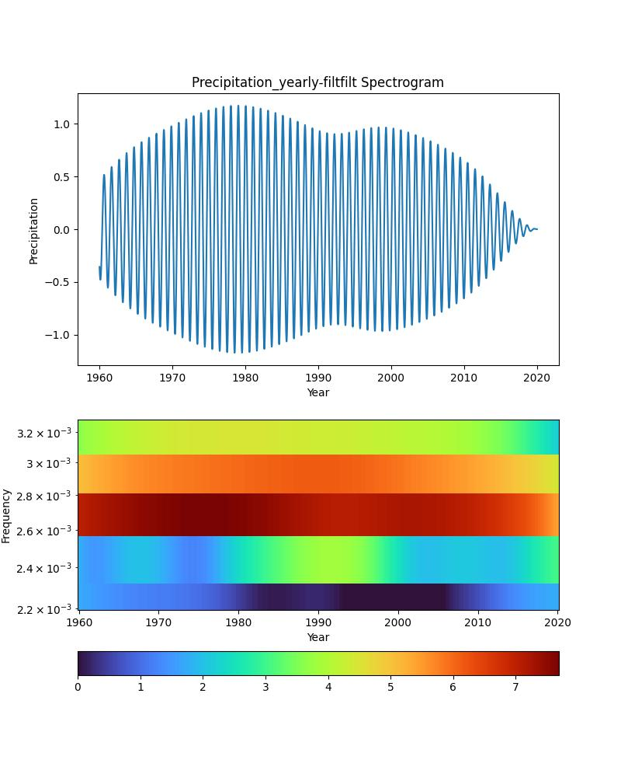
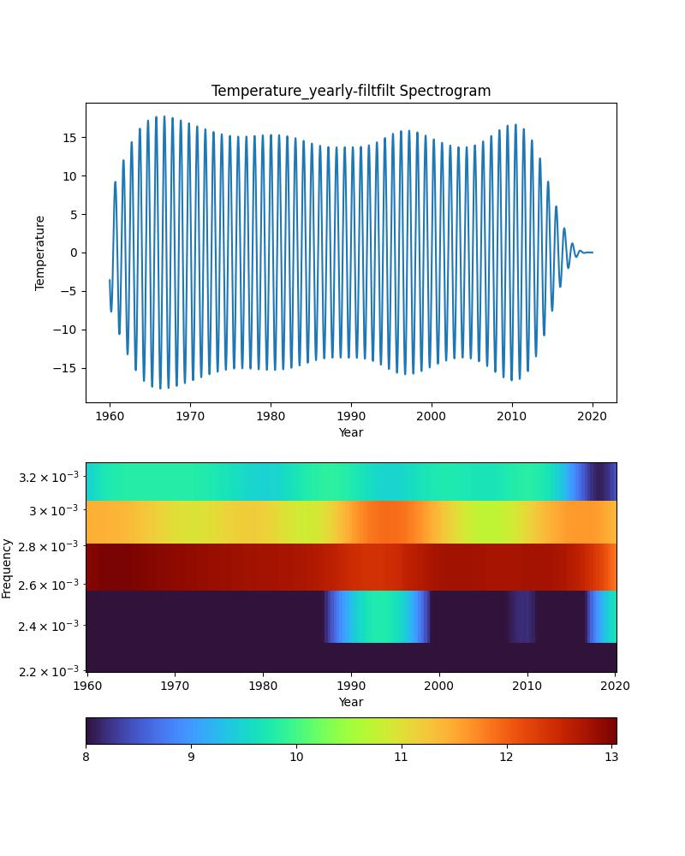
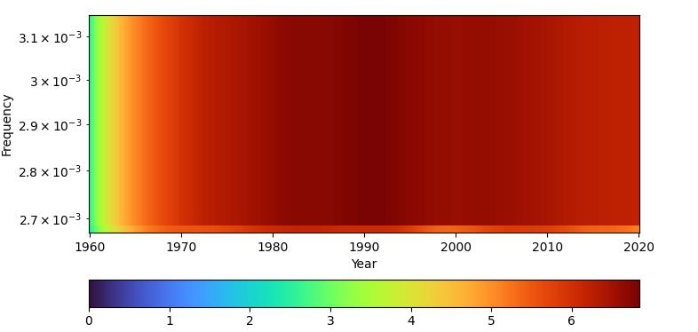
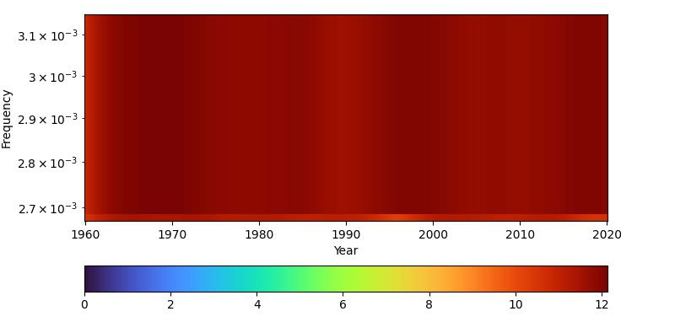
Results - Filters and Spectrograms
Yearly filter:
Slight fluctuation throughout time, but mostly uniform

Slide 9
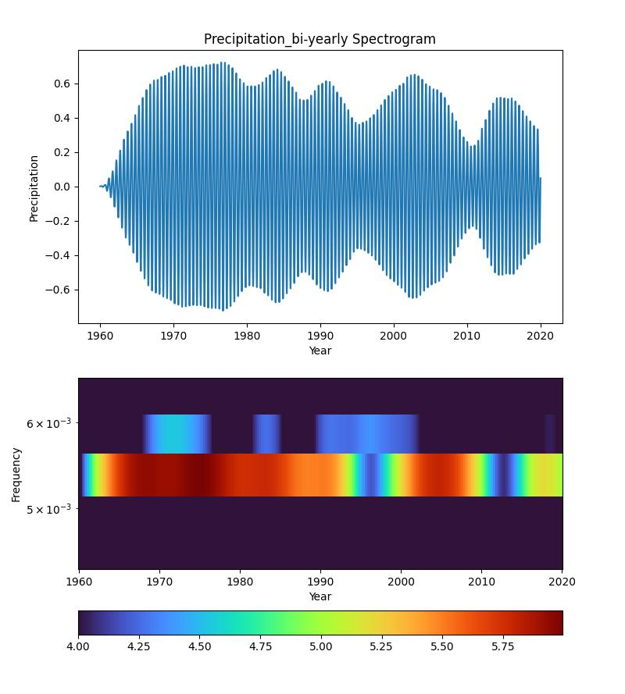
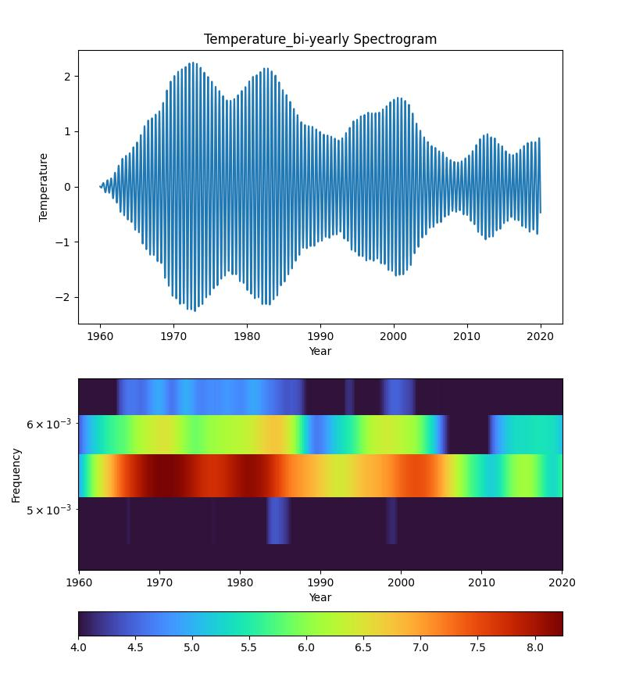
Results - Filters and Spectrograms
Bi-yearly filter:
Significant anomalies at multiple points
Two major anomalies, several smaller ones
Major anomalies show up at similar times for both temperature and precipitation

Slide 10
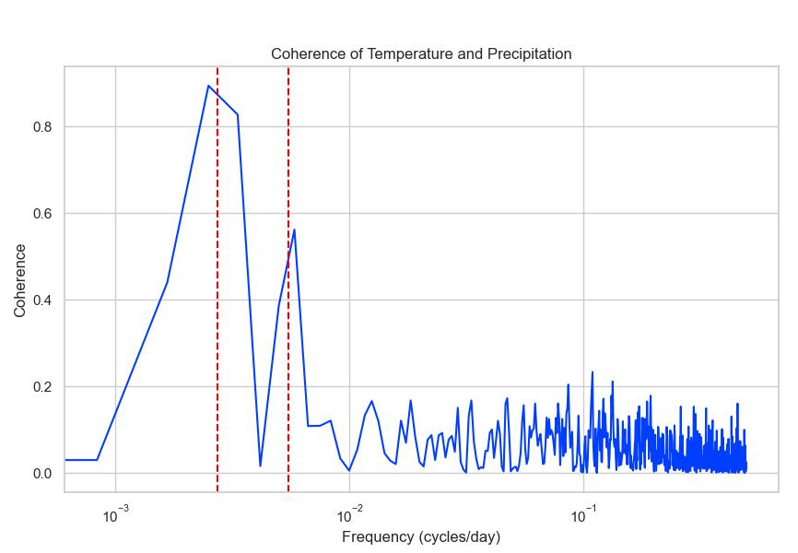
Results - Coherence
Anomalies occurred in the bi-yearly frequency for both temperature and precipitation
Use coherence to check the correlation between the two at different frequencies
Coherence is strongest at the two peak frequencies

Slide 11
Other Studies
Research on temperature and precipitation patterns have found similar peak frequencies and coherence between the two
Similar methods have been used for anomaly detection in other fields
Ex. detecting abnormal heart rhythms with spectrograms generated from EKGs
Often make use of neural networks to automate detection

Slide 12
Future Research
Use wavelet transform and scalogram for more accurate representation of changes through time
Study more locations and more variables to establish a pattern on a larger scale
Research conditions at each location during the anomalous times
Determine physical interpretation of these anomalies
Use a neural network to make anomaly detection automatic

